Slide 1
Managing Information Technology Resources ITWS 4310
Understanding Software
Software in Flux
October 1, 2018

Slide 2
Managing IT Resources Class Outline: Mon, Oct 1, 2018
MITR Term Project
Schedule Meetings with Client and Invite Faculty to Meetings
Work on “System Requirements” with Client due as part of “Initial Sections” on Oct 9 by 9 PM
Work on “Risk Management Plan” due as part of “Initial Sections” on Oct 9 by 9 PM
Submit updated “CBA” due as part of “Initial Sections” on Oct 9 by 9 PM
“Initial Sections” for Project Due Tues Oct 9 by 9:00 PM
Mid-Term Exam on Monday Oct 15 during class from 10 AM – 11:50 AM
See past Mid-Term Exams posted on LMS
How to Do a Business Case – 1st Business Case is “Netflix” with Case Answers due prior to class (9:59 AM) on Tues Oct 9
Current Events
Understanding Software: Chapter 13 in Gallaugher Text
Software in Flux: Chapter 14 in Gallaugher Text

Slide 3
Managing IT Resources: ITWS 4310 Term Project Report Outline
Section 1: Executive Summary
Section 2: Introduction
Section 3: Client Organization and Description
Section 4: Project Team
Section 5: Problem Statement
Section 6: IS/IT Solution
Section 7: Methodology
Section 8: IS/IT Requirements
Section 9: IS/IT Design
Section 10: Cost-Benefit Analysis with (Risk Mgmt)
Section 11: Project Plan/Schedule/Resources
Section 12: Post-Turnover Plan
Section 13: Results and Client Feedback
Section 14: Conclusions
Project Proposal:
Requirements
Part of Initial Sections:
due Oct 9 by 9 PM
Cost-Benefit Analysis
Project Plan

Slide 4
Business Case Analysis
Read the Case.
The Case is a “story” about a relevant IT company or situation intended to provide experiential learning about the topics in this course.
Read the Case Questions.
Re-read the case with the questions in mind.
Research material about the company on its website, financial sites (www.reuters.com/finance/stocks, www.google.com/finance, www.finance.yahoo.com), and other current media.
Think about the Case questions. You are encouraged to meet in groups to discuss the case questions.
Be prepared to discuss and answer all the Case Questions during class.
Write and submit the answer to the one written Case question that is to be submitted on LMS individually prior to class.

Slide 5
How to Write the Business Case
Do not simply summarize the Case.
Be sure to Answer the Question(s).
The length should be 1-2 pages, single-spaced, 12 point font with normal borders.
Use both qualitative and quantitative arguments to support your answer.
Use concepts and data from the Case and the FWK textbook.
Use concepts and data from online research.
Show insight. It is ok to include personal knowledge.
Words without numbers are fair at best.
Numbers without words are fair at best.
Use good quality English language: style, rhetoric, grammar, spelling, references.

Slide 6
Surprise! Quiz
10 Minutes

Slide 7
Technology Current Events: “Facebook Is Breached by Hackers, Putting 50 Million Users’ Data at Risk”, The New York Times, Sept 28, 2018 https://www.nytimes.com/2018/09/28/technology/facebook-hack-data-breach.html
Facebook said on Friday that an attack on its computer network had exposed the personal information of nearly 50 million users.
The company said it discovered the breach this week. The attackers exploited a feature in Facebook’s code that allowed them to take over user accounts. Early Friday, Facebook forced more than 90 million users to log out of their accounts, a common safety measure taken when accounts have been compromised.
Facebook said it had fixed the vulnerability and notified law enforcement officials.
The attackers exploited two bugs in the site’s “view as” feature, which allows users to view their own profiles as if they were someone else, Facebook said. The feature was built to give users more control over their privacy.
That was compounded by a flaw in Facebook’s video-uploading program, a software feature that was introduced in July 2017, the company said. The flaw allowed the attackers to steal so-called access tokens — digital keys that allow access to an account.

Slide 8
Technology Current Events: “Tesla shares sink on SEC lawsuit, sources say Musk could settle”, Reuters UK, Sept 28, 2018 https://uk.reuters.com/article/uk-tesla-musk-stocks/tesla-shares-sink-on-sec-lawsuit-sources-say-musk-could-settle-idUKKCN1M81DH
Tesla Inc’s (TSLA.O) Elon Musk could settle with U.S. regulators who have sued to remove him from the electric carmaker’s leadership, but he is prepared to fight the securities fraud lawsuit against him in court, sources said on Friday as shares plunged about 14 percent.
Musk, Tesla’s chairman and chief executive, has been directly involved in almost every detail of its product development and technology strategy, and is credited as the driving force behind the loss-making company’s ability to raise capital.
The U.S. Securities and Exchange Commission (SEC) accused Musk on Thursday of tweeting false and misleading information in August about financing for his now-abandoned plan to take the company private, and said it was seeking to remove him as an officer or director.
Musk, 47, walked away at the last minute from a settlement with the SEC that would have required him to give up key leadership roles at the company for two years and pay a nominal fine, according to reports on Friday.
But sources, who requested anonymity because they were not authorized to discuss the matter publicly, told Reuters that while Musk was ready to go to trial he could still settle. They did not discuss possible terms.

Slide 9
Technology Current Events: “Slack is planning to go public in 2019 at a reported $7 billion valuation”, Business Insider, Sept 28, 2018 https://www.businessinsider.com/slack-plans-ipo-in-2019-2018-9
The initial public offering is scheduled to take place by fall 2019 and could value Slack at about $7 billion, The Journal reported, citing sources familiar with the company's plans.
A representative for Slack said the company does not comment on "rumors and speculation.”
In 2017, Slack CEO Stewart Butterfield told Bloomberg that an IPOwas still a long way off. The company in August closed a $427 million funding round, led by Dragoneer Investment Group and General Atlantic, that valued it at more than $7 billion.
The Journal's sources said that while the San Francisco-based company has yet to hire underwriters, it is actively preparing to go public.
Slack was founded in 2009. Its popular work-chat software is estimated to be used by 8 million people daily.

Slide 10
Chapter 13
Understanding Software: A Primer for Managers

Slide 11

Introduction
Computing hardware: Physical components of information technology, which includes the computer and its peripherals
Storage devices
Input devices
Output devices
Software: Computer program or collection of programs.
Precise set of instructions that tells hardware what to do.

Slide 12
Software
Operating system:
Applications:

Slide 13
Software
Operating system: Software that controls the computer hardware
Establishes standards for developing and executing applications
Applications: Desktop applications, enterprise software, utilities, and other programs that perform specific tasks for users and organizations

Slide 14
The Hardware/Software Stack
USER
APPLICATIONS
Microsoft Office, MySQL, Angry Birds
OPERATING SYSTEM
HARDWARE
Microsoft Windows, Linux, Mac OSX, iOS

Slide 15
Operating Systems
Provide a common set of controls for managing computer hardware
Make it easier for users to interact with computers and for programmers to write application software.
User interface: Mechanism through which users interact with a computing device.
Firmware: Software stored on nonvolatile memory chips.
Embedded Systems: Special-purpose software designed and included inside physical products.

Slide 16
Application Software
Software that Performs the work that users and firms are directly interested in accomplishing
Platform: Products and services that allow for the development and integration of software products and other complementary goods
Desktop software: Applications installed on a personal computer, typically supporting tasks performed by a single user

Slide 17
Enterprise software

Slide 18
Enterprise Software
CUSTOMER RELATIONSHIP MANAGEMENT (CRM)
Systems used to support customer-related sales and marketing activities.
SUPPLY CHAIN MANAGEMENT
Systems that can help a firm manage aspects of its value chain through delivery of finished products and services at the point of consumption.
BUSINESS INTELLIGENCE (BI) SYSTEMS
Systems that use data created by other systems to provide reporting and analysis for organizational decision making.

Slide 19
Database Management System
Software for creating, maintaining, and manipulating data
Referred to as database software.
Stores and retrieves the data created and used by enterprise applications.
Firms with common database systems and standards benefit from increased organizational insight and decision-making capabilities.

Slide 20
Database management system
SCM
SCM
ERP
CRM
PROPRIETARY
Partner’s
Systems
DATABASE
Organization’s Systems

Slide 21
Distributed Computing

Slide 22
Distributed Computing
Form of computing where systems in different locations communicate and collaborate to complete a task
Server: Program that fulfills the requests of a client
Hardware context - Computer that has been configured to support requests from other computers
Software context - Program that fulfills requests
Client: Software program that makes requests of a server program

Slide 23
Distributed Computing
APPLICATION SERVER
Software that houses business logic for use by multiple applications.
WEB SERVICES
Small pieces of code that are accessed via the application server that permit interoperable machine-to-machine interaction over a network.
Used by more advanced distributed environments.
APPLICATION PROGRAMMING INTERFACE (API)
Programming hooks, or guidelines, published by firms that tell other programs how to get a service to perform a task such as send or receive data.
SERVICE-ORIENTED ARCHITECTURE (SOA)
Set of Web services built around an organization’s processes and procedures.

Slide 24
Total Cost of Ownership
All of the costs associated with any form of capital, including a software system
Design
Development
Testing
Implementation
Documentation
Training
Maintenance

Slide 25
Why Do Technology Projects Fail?

Slide 26
Why Do Technology Projects Fail?
Unrealistic or unclear project goals
Poor project leadership and weak executive commitment
Inaccurate estimates of needed resources
Badly defined system requirements
Allowing feature creep during development
Poor reporting of the project’s status
Poor communication among customers, developers, and users
Use of immature technology
Unmanaged risks
Inability to handle the project’s complexity
Sloppy development and testing practices
Poor project management
Stakeholder politics
Commercial pressures

Slide 27
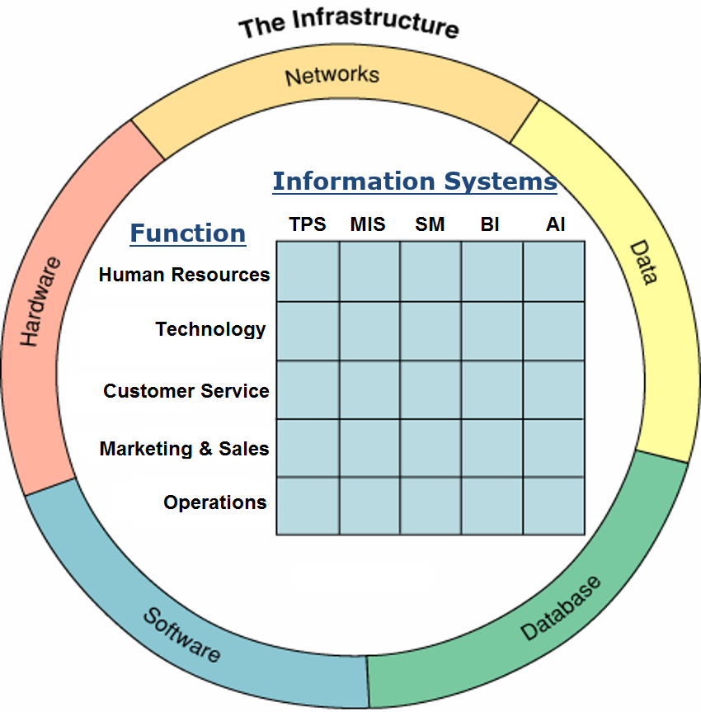
Project Architecture Diagram
Technology
Hardware
Software
Networks
DB & Data
Processes
People

Slide 28
Chapter 14
Software in Flux: open source, cloud, and virtualized and app-driven shifts

Slide 29
Software Industry
Marginal cost: Cost of producing one more unit of a product
Is effectively zero to produce an additional copy of a software product.
Network effects and switching cost can offer a degree of customer preference and lock in.
Open source software (OSS): Software that is free and where anyone can look at and potentially modify the code.
Cloud computing: Replacing computing with services provided over the Internet.
Software as a service (SaaS): Firm subscribes to a third-party software and receives a service that is delivered online.
Virtualization: Technology that can make a single computer behave like many separate computers.
Helps consolidate computing resources and creates additional savings and efficiencies.

Slide 30
Open Source Software
Linux: Open source software operating system.
Source code for OSS products is openly shared.
Can be changed and redistributed by anyone.
In stark contrast to the practice of conventional software firms who:
Treat their intellectual property as closely guarded secrets.
Almost never provide the source code for their commercial products.
Seen by some firms as a threat that undermines their economic model.
LAMP: Acronym for Linux, Apache Web server software, MySQL database, and Perl/Python/PHP.
Powers many of the sites visited each day, from Facebook to YouTube.

Slide 31
What are advantages of Open Source Software?

Slide 32
What are advantages of Open Source Software?
Advantages
Low cost
Increased reliability
Improved security and auditing
System scalability
Firms can improve time to market
Fewer bugs due to large number persons looking at code

Slide 33
What are disadvantages of Open Source Software?

Slide 34
What are disadvantages of Open Source Software?
Disadvantages
Support not included in the free or lowest cost models
Sometimes difficult to install and maintain
For vendors: no proprietary competitive advantage
For vendors: reduces revenues
Complexity of some products
Total cost of ownership increases for some products
Legal and licensing concerns

Slide 35

Why Open Source?
Cost
Reliability
Security
Security focused: Technology products that contain particularly strong security features.
Scalability: Ability to either handle increasing workloads or to be easily expanded to manage workload increases.
Agility and time to market.

Slide 36
Examples of Open Source Software
Firefox
OpenOffice
Gimp
Alfresco
Marketcetera
Zimbra
MySQL, Ingres, and PostgreSQL
HBase and Cassandra
SugarCRM
Asterix
Free BSD and Sun’s OpenSolaris

Slide 37

Business of Open Source
Vendors make money on OSS by selling support and consulting services.
Industry’s evolution (standards competition):
Pre-Linux days: Almost every major hardware manufacturer made its own incompatible version of the Unix operating system.
As such, they had difficulty attracting third-party vendors to write application software.
Now all major hardware firms run Linux, resulting in a large, unified market attracting software developers.

Slide 38
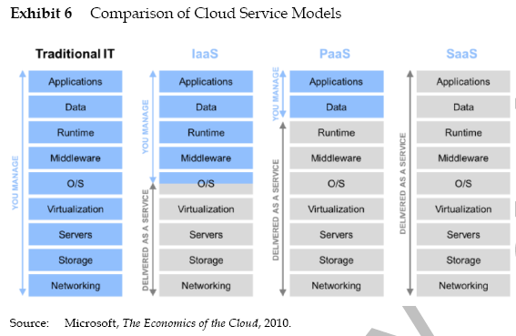
Cloud Service Models

Slide 39
What are advantages of “The Cloud”?

Slide 40
What are advantages of “The Cloud”?
Advantages
Lower costs by reducing software, hardware, maintenance and staff expenses
Financial risk mitigation
Potentially faster deployment
Variable expenses instead of Capital Expenses
Scalable systems
Higher quality and service through instant upgrades
Remote access and availability

Slide 41
What are disadvantages of “The Cloud”?

Slide 42
What are disadvantages of “The Cloud”?
Disadvantages
Dependence on single vendor
Viability of partner firms
Forced to move to newer versions
Reliance on network connections
Limited customization
Sometimes higher life cycle costs

Slide 43
Cloud Computing
Private clouds: Pools of computing resources that reside inside an organization and that can be served up for specific tasks as need arrives.
Evolution of cloud computing has huge implications across the industry:
Financial future of hardware and software firms.
Cost structure and innovativeness of adopting organizations.
Skill sets likely to be most valued by employers.

Slide 44
Earning Money Through SaaS
Money can be earned via a usage-based pricing model similar to a monthly subscription.
Other SaaS firms:
Offer free services that are supported by advertising.
Promote the sale of upgraded or premium versions for additional fees.
Compete directly with the biggest names in software.

Slide 45
Benefits of SaaS to users
Lower costs and financial risk mitigation.
Faster deployment times and variable operating expense.
Scalable systems.
Higher quality and service levels.
Remote access and availability.
Limits development to a single platform.
Tighter feedback loop.
Ability to instantly deploy bug fixes and product enhancements.
Lower distribution costs.
Greater accessibility.
Reducing software piracy.

Slide 46
Risks Associated with SaaS
Dependence on a single vendor.
Concern about the long-term viability of partner firms.
Users may be forced to migrate to new versions.
Possibly incurring unforeseen training costs and shifts in operating procedures.
Reliance on a network connection, which may be slower, less stable, and less secure.
Data assets stored off-site may lead to security and legal concerns.
Limited configuration, customization, and system integration options compared to packaged software or alternatives developed in-house.
User interface of Web-based software is less sophisticated and lacks the richness of most desktop alternatives.
Ease of adoption may lead to pockets of unauthorized IT being used throughout a firm.

Slide 47
Cloud Offerings
Hardware and software exists “in the cloud,” meaning somewhere on the Internet.
You only pay for the amount of processing, storage, and telecommunications used.
Cloud vendors typically host your software on their systems.
Cloud computing efforts focus on providing a virtual replacement for a subset of operational hardware like storage and backup solutions.
SaaS provides the software and hardware to replace an internal information system.
A firm replaces software and hardware with a service provided by a third party online.

Slide 48

Cloud services
Examples of hardware cloud services:
Salesforce.com offers Force.com.
Includes several cloud-supporting tools to write applications specifically tailored for Web-based delivery.
Google’s App Engine offers developers several tools.
Including a database product called Big Table.
Microsoft offers Windows Azure.

Slide 49
Cloud Providers
Platform as a service (PaaS): Cloud providers offer services for customers to build their own applications on the provider’s infrastructure.
Services include hardware, operating system, tools, and hosting.
Infrastructure as a service (IaaS): Cloud providers offer services that include running the remote hardware, storage, and networking.
Client firms can choose the software used.
Estimated Monthly Costs to Run a Website with 50 Million Monthly Page Views.

Slide 50
Clouds in Action
CLOUDBURSTING
Use of cloud computing to provide excess capacity during periods of spiking demand.
BLACK SWANS
Events that cannot be predicted but can cause an impact.
It is a scalability solution that is provided as an overflow service, kicking in as needed.
Scalable computing resources can help a firm deal with spiking impact from Black swan events.

Slide 51
Cloud Computing Challenges
Installing a complex set of systems on someone else’s hardware is very difficult.
Firms considering cloud computing need to do a thorough financial analysis.
Firms should enter the cloud cautiously, particularly where mission-critical systems are concerned.

Slide 52
Clouds and Tech Industry Impact
Shifting to cloud computing modifies the margin structure for many in the computing industry.
Cloud computing can accelerate innovation.
Changes the desired skills mix and job outlook for IS workers.
Enables organizations to spend less on hardware infrastructure and reinvest in strategic efforts and innovation.
Firms need to think about the strategic advantages that can be created.
This server-packed shipping container from
Oracle’s Sun unit is designed for rapid data
center deployment.

Slide 53
Server Farm
Massive network of computer servers running software to coordinate their collective use
Provide the infrastructure backbone to SaaS, hardware cloud efforts, and many large-scale Internet services.
Require plenty of cheap land, low-cost power, ultrafast fiber-optic connections, and benefit from mild climates.
Google, Sun, Microsoft, IBM, and HP have all developed rapid-deployment server farm modules.

Slide 54
Virtualization
A type of software that Allows a single computer or cluster of connected computers to function as if it were several different computers
Each computer runs its own operating system and software.
Can be used to reduce an organization’s hardware needs.
Can create a firm’s own private cloud of scalable assets.
Can cut energy consumption and lower carbon footprint.

Slide 55
Virtualization
Containers: a type of virtualization that allows for shared operating systems for more resource savings and faster execution.
Virtual desktops: Running an instance of a PC’s software on another machine and delivering the image of what is executing to the remote device.
Allow firms to scale and upgrade systems far more easily than if they had to maintain each individual PC.

Slide 56
Apps and App Stores
Compared with packaged software, apps lower the cost of software distribution and maintenance.
Apps offer a richer user interface and integrate more tightly with a device’s operating system.
Huge firms have leveraged smartphone apps as their only, or primary interface with consumers.
Critics say apps force consumers into smartphone walled gardens and raise consumer switching costs.

Slide 57
Variables to Consider for Technology Decisions
COMPETITIVE ADVANTAGE
SECURITY
LEGAL AND COMPLIANCE REQUIREMENTS
SKILL, EXPERTISE, AND AVAILABLE LABOR
COST AND TIME
VENDOR ISSUES
Notes:
Competitive Advantage—Do we rely on unique processes, procedures, or technologies that create vital, differentiating competitive advantage?
Security—Are there unacceptable risks associated with using the packaged software, OSS, cloud solution, or an outsourcing vendor?
Leal and Compliance—Is our firm prohibited outright from using technologies? Are there specific legal and compliance requirements related to deploying our products or services?
Skill, Expertise, and Available Labor—Can we build it? The firm may have skilled technologists, but they may not be sufficiently experienced with a new technology. Even if they are skilled, managers must consider the costs of allocating staff away from existing projects for this effort.
Cost—Is this a cost-effective choice for our firm?
Time—Do we have time to build, test, and deploy the system?
Vendor Issues—Is the vendor reputable and in a sound financial position? Can the vendor guarantee the service levels and reliability we need?

Slide 58
Project Architecture Diagram
Technology
Hardware
Software
Networks
DB & Data
Processes
People
TPS: Transaction Processing System
MIS: Management Information System
SM: Social Media
BI: Business Intelligence, Analytics
AI: Artificial Intelligence

Slide 59
Managing IT Resources Week 6 Assignments – Oct 1 - 4
Read Chapter 8, Platforms, Network Effects, and Competing in a Winner-Take-All World in the Gallaugher text for Thurs Oct 4.
Read Chapter 16, A Manager’s Guide to the Internet and Telecommunications in the Gallaugher text for Thurs Oct 4.
Work on “System Requirements” with Client due as part of “Initial Sections” on Oct 9 by 9 PM
Risk Management Term Project Assignment for All Teams due as part of “Initial Sections” due Tues Oct 9 by 9 PM
Updated CBA due as part of “Initial Sections” due Tues Oct 9 by 9 PM
Netflix Case – Tuesday Oct 9: Assignment due by 9:59 AM
Assignment to be made available no later than Weds night (10/3)
Midterm Exam – Monday Oct 15 during class

